Slide 1

Bankruptcy classification project

Slide 2
PROJECT TEAM GROUP 3
Mentors
Neha
Sunkarapelli Mounika
Team members
Siddharth Subhash Galande
Pratik Ashok Patil
Basava Pavan Sri Ram
Saranya Prasad L
Ashish Kumar Pankaj
Shubham Dilip Fulzele
Mihir Atul Humnabadkar

Slide 3
INDEX
Project objective and dataset
Variable description
Exploratory data analysis
Histograms, Boxplots and Scatter plots
Bar charts and Density plots
Skewness and Kurtosis
Heatmap
Outlier detection
Scaling
Model building : Linear, Lasso, Ridge, Decision Tree, Random Forest, ADA Boost, XG Boost and SVR
Model evaluation
Model Performance and Evaluation Parameter matrix
Final Insights and Observations
Deployment Interface
Challenges and Solutions

Slide 4
Project objective and dataset
The variable to be predicted is Bankruptcy.
The primary goal is to model bankruptcy as a function of environmental variables using classification.
The dataset Bankruptcy Prediction.csv has been provided for the project.
It contains 96 variables and 6819 rows.

Slide 5
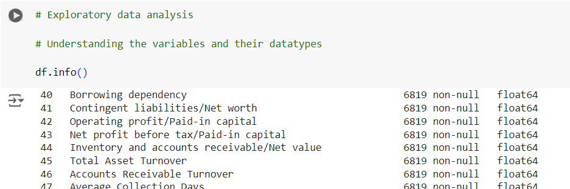
Exploratory data analysis
EDA has been done using pandas, numpy, seaborn and matplotlib.

Slide 6
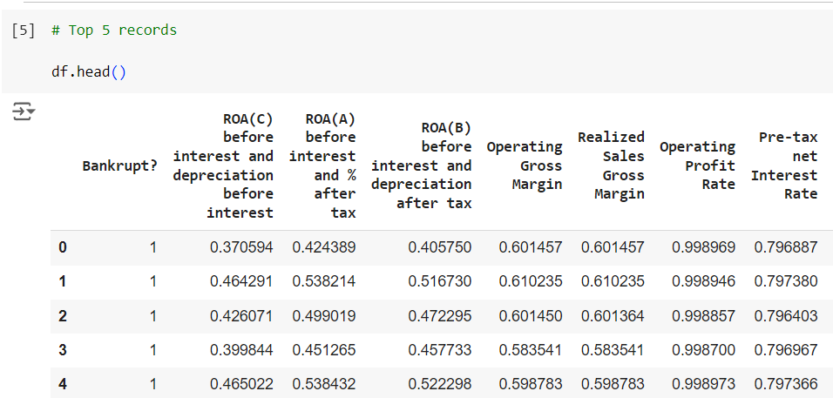
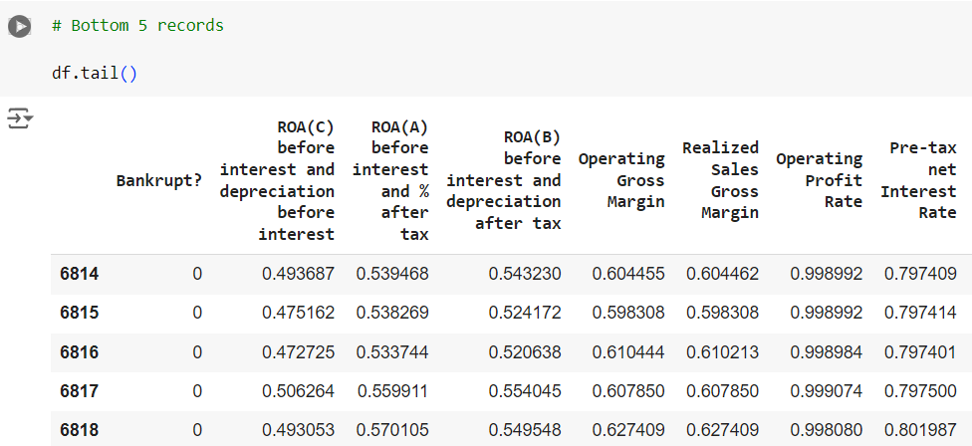
Exploratory data analysis

Slide 7
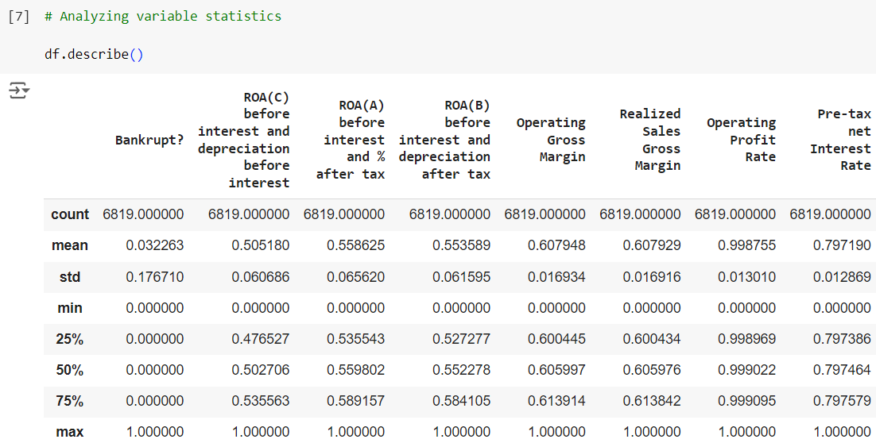
Exploratory data analysis

Slide 8
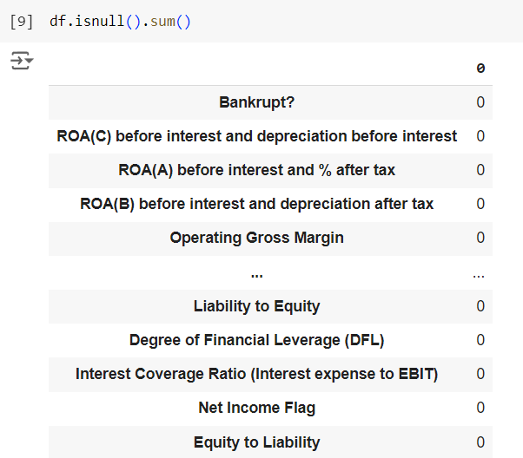

Exploratory data analysis
There are no null values in the dataset.
There are no categorical variables in the dataset so one hot encoding or label encoding has not been done.

Slide 9
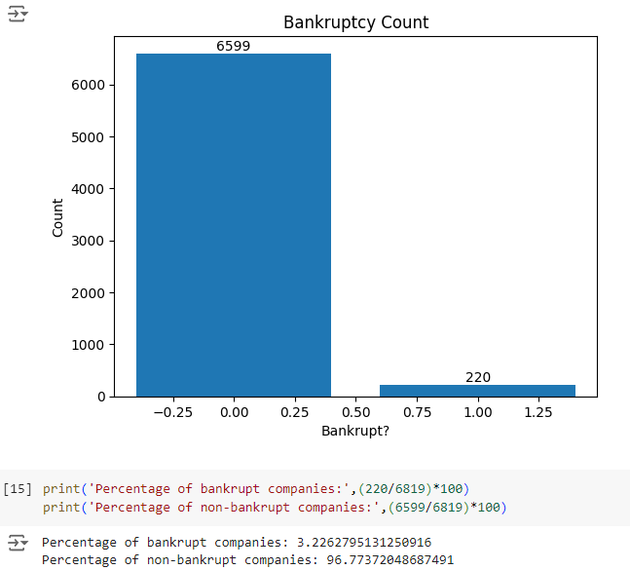
Bankruptcy count

Slide 10
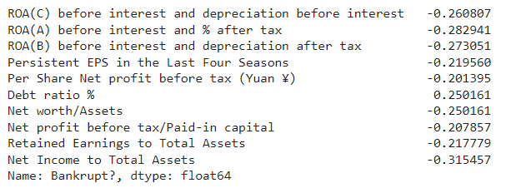
Variables with high correlation with bankruptcy

Slide 11
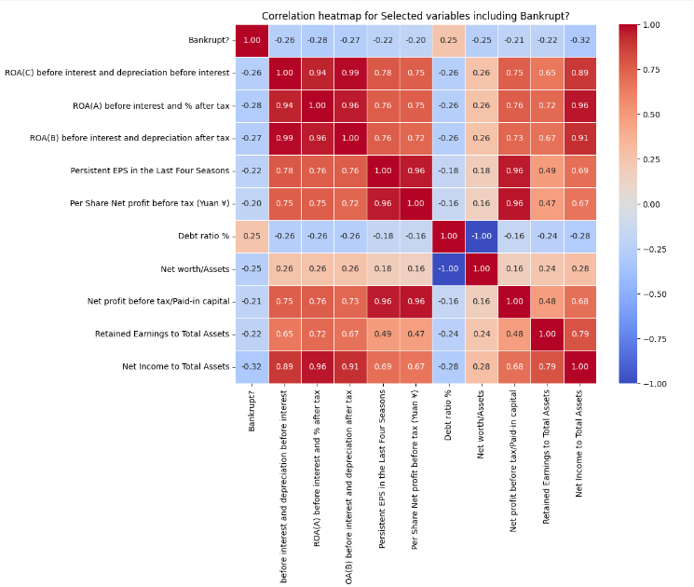
Correlation matrix

Slide 12
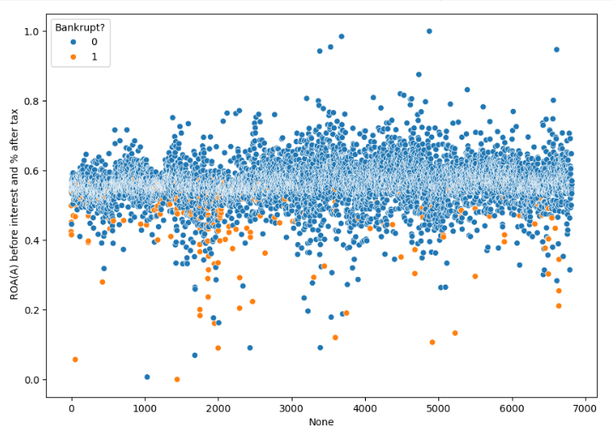
Scatter plots

Slide 13
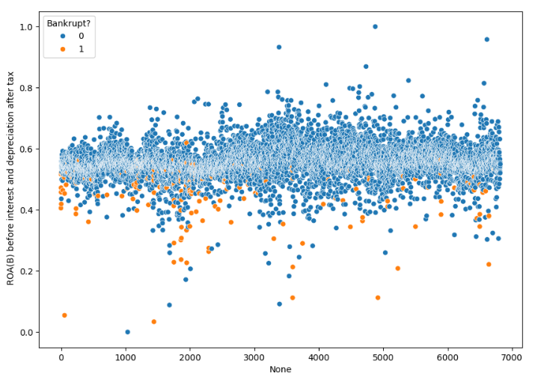
Scatter plots

Slide 14
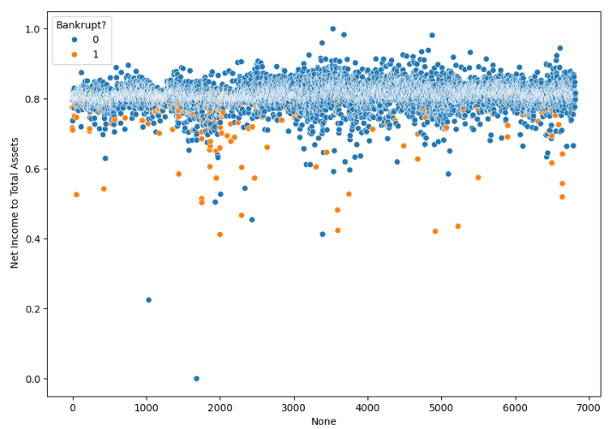
Scatter plots

Slide 15
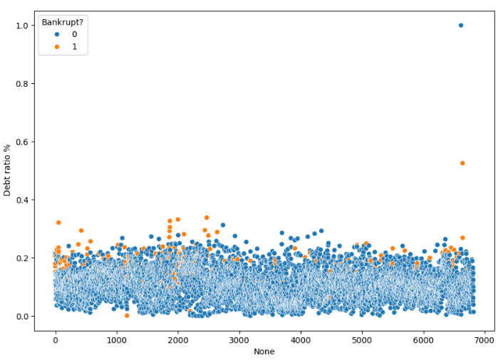
Scatter plots

Slide 16
Scatter plot insights
Higher the ROA(A) before interest and % after tax, less chances are the company will be bankrupt.
Higher the ROA(B) before interest and depreciation after tax, less chances are the company will be bankrupt.
Higher the Net Income to Total Assets, less chances are the company will be bankrupt.
Higher the Debt ratio %, more chances are the company will be bankrupt.

Slide 17
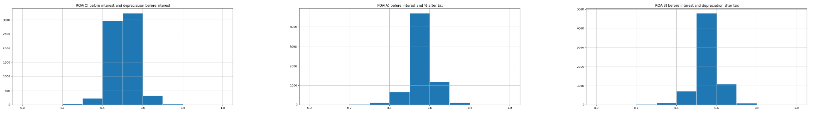
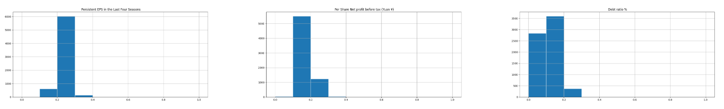
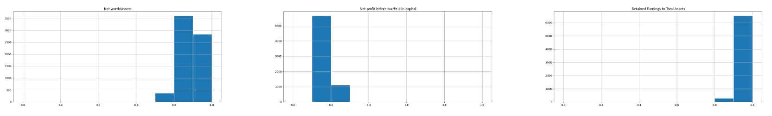
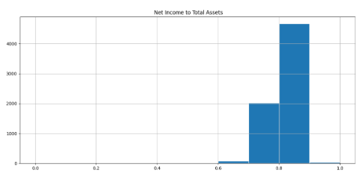
histograms

Slide 18
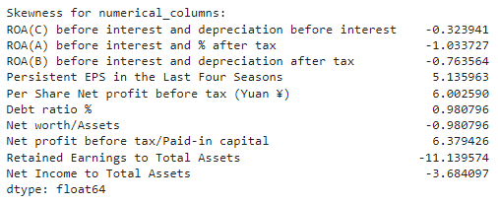
skewness

Slide 19
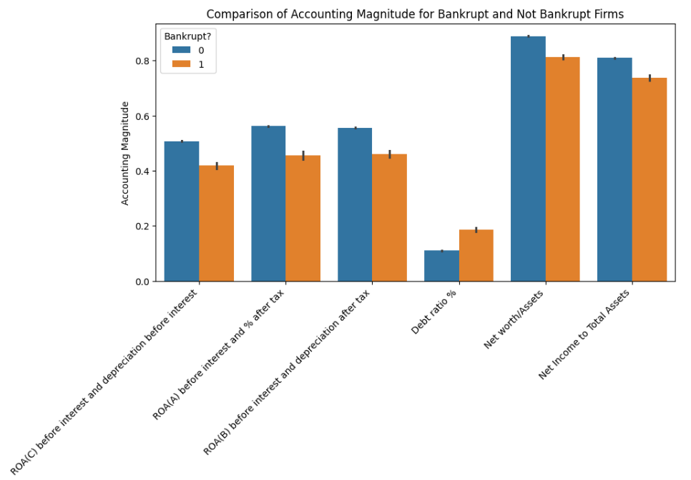
Accounting magnitude

Slide 20
Magnitude insights
The series of bar plots visually compares the accounting magnitudes for each of the selected variables between two groups:
bankrupt firms (represented by the color 0) and firms that are not bankrupt (represented by the color 1).
By examining the bars for each variable, we can observe how the accounting magnitude differs between bankrupt and non-bankrupt firms for the selected variables. If the bars for a particular variable show a significant difference between the two groups, it may suggest that the variable is important in distinguishing bankrupt and non-bankrupt firms based on accounting metrics.
Overall, this visualization provides valuable insights into the relationship between the selected accounting variables and the likelihood of bankruptcy for the analyzed firms.

Slide 21
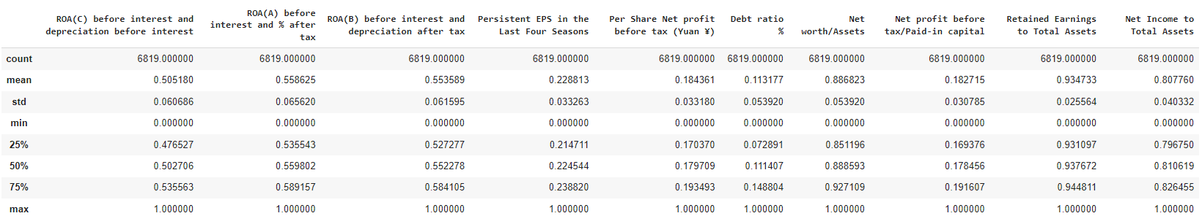
Descriptive statistics for selected variables

Slide 22
statistics insights
From the descriptive statistics, we can observe that all the variables appear to have been scaled between 0 and 1, but they are not standardized with a mean of 0 and a standard deviation of 1.
The mean and standard deviation values are specific to each variable, and they provide information about the central tendency and spread of the data for each variable.
The minimum and maximum values also show the range of values each variable can take.

Slide 23
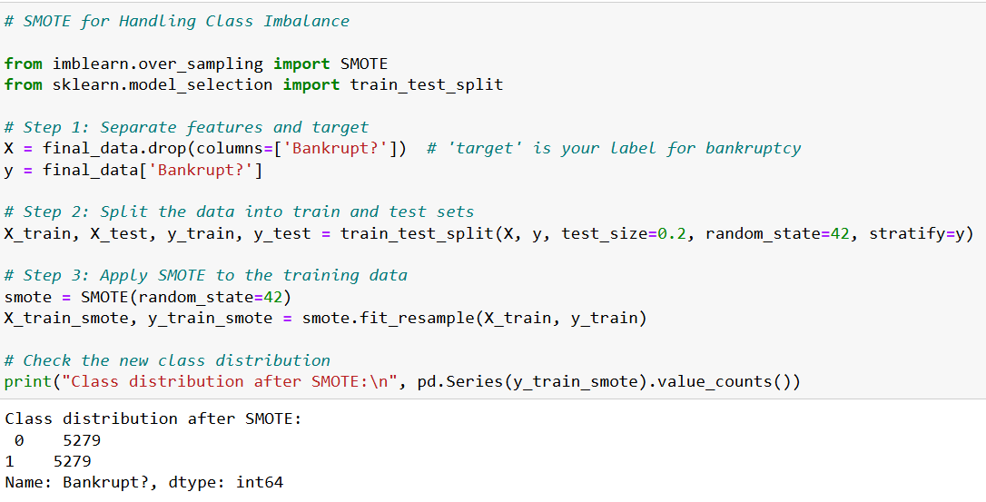
Handling class imbalance

Slide 24
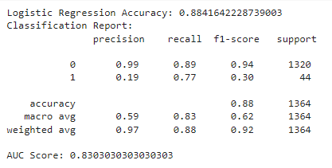
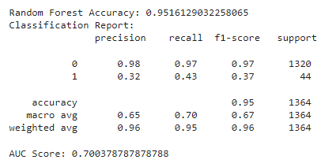
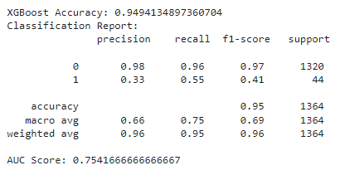
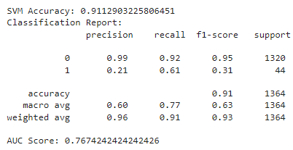
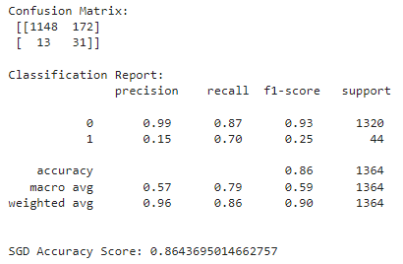
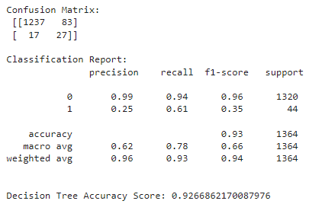
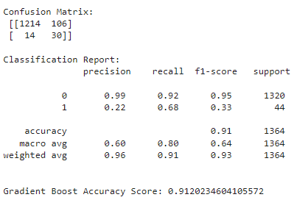
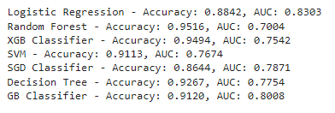
Model building

Slide 25
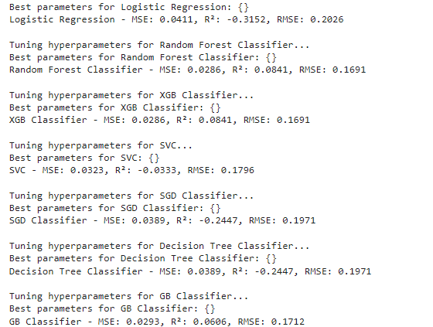
Best hyperparameters

Slide 26
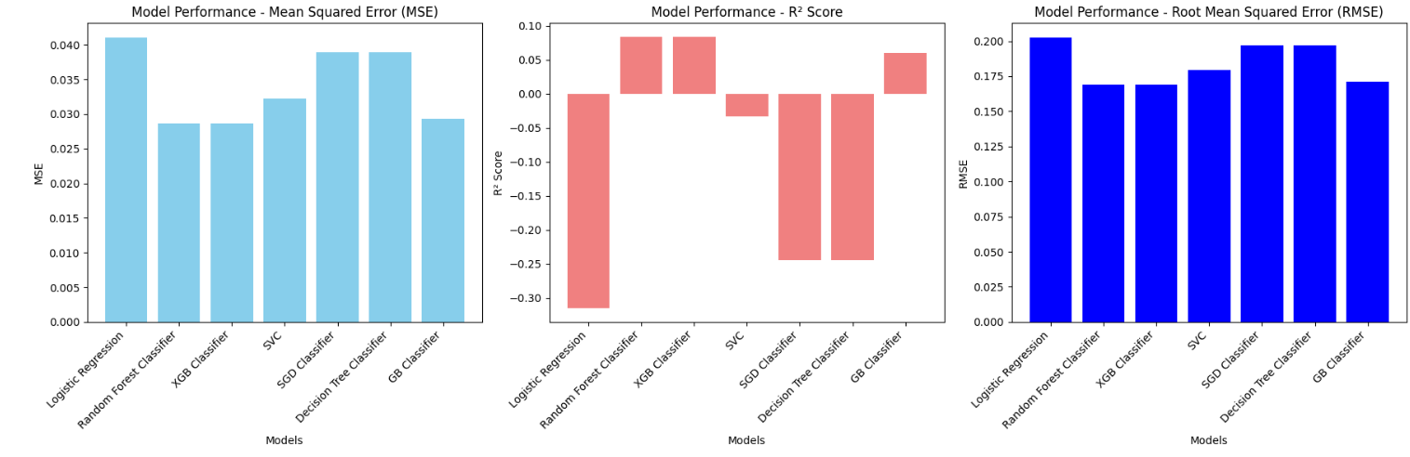
Model performance evaluation

Slide 27
Performance conclusions
The model has been built and evaluated using 7 different algorithms
Random Forest and XG Boost are the 2 best algorithms with highest accuracy score and lowest errors.
Out of them Random Forest has the highest accuracy score and the best fit for this dataset.

Slide 28
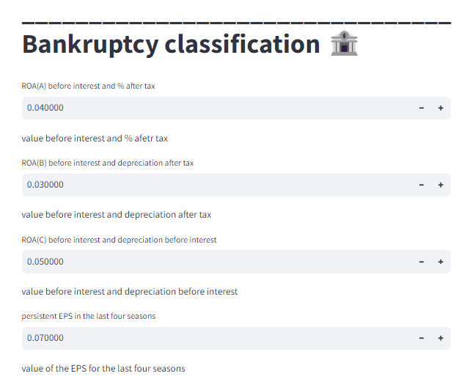
Deployment

Slide 29
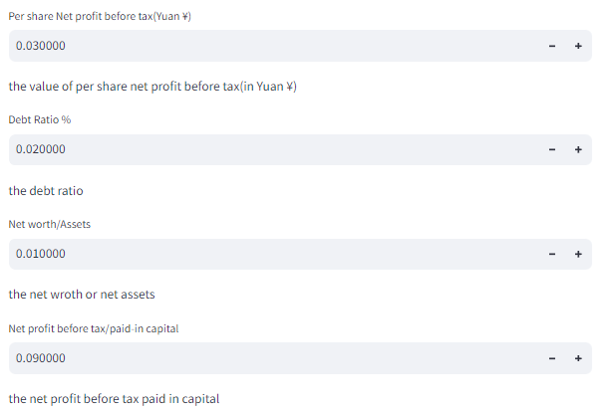
Deployment

Slide 30
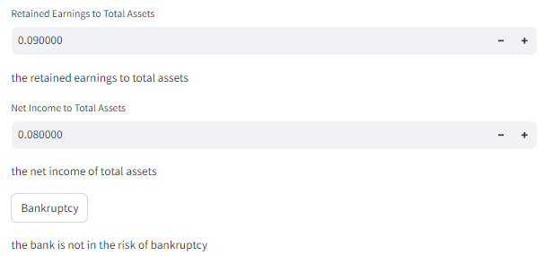
Deployment

Slide 31
Challenges and solutions
There were 96 columns in the dataset which is a large number of inputs.
Using threshold value method, we reduced the number to 10 variables which had the highest absolute correlation with the target variable Bankruptcy.
Class imbalance had to be handled using sampling method.

Slide 32
THANK YOU!!!

